Slide 1



I am glad you are in multimedia class

Slide 2
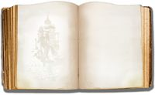
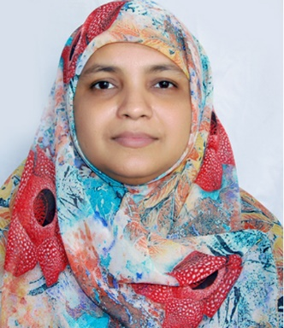
    English 1st Paper
    Class : Seven
    Unit: Nine
    Climate Change
    Lesson: Four
    What happens next
    Time : 45 minutes
Lutfunnissa Khanom
Assistant Teacher(English)
Jamalkhan Kusum Kumari City Corporation Girls’ High School
Rahmatgonj, Chittagong.
Email: lutfunnissa@gmai.com
Mobile+8801713108801

Slide 3
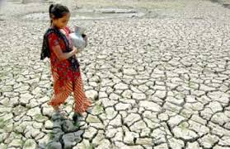
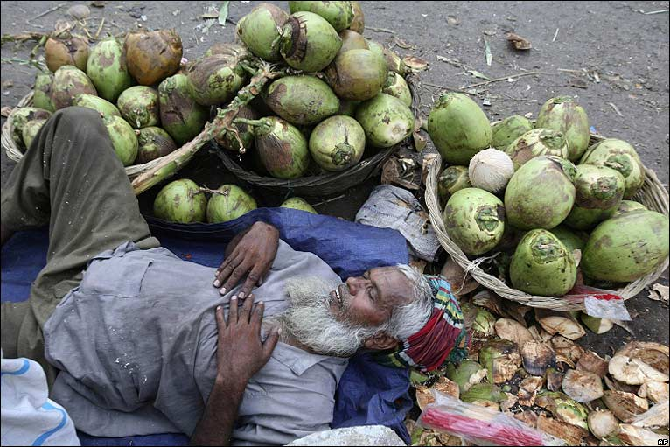
Let us see some pictures
Drought in North Bangle
Please recall your previous lesson.
Higher Temperature

Slide 4
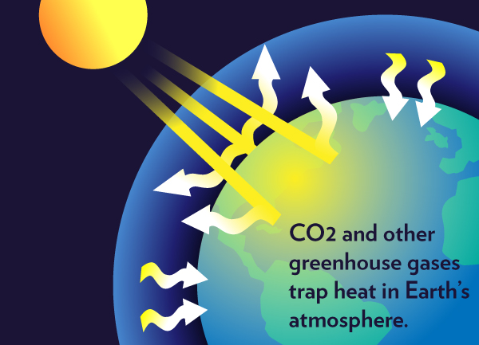
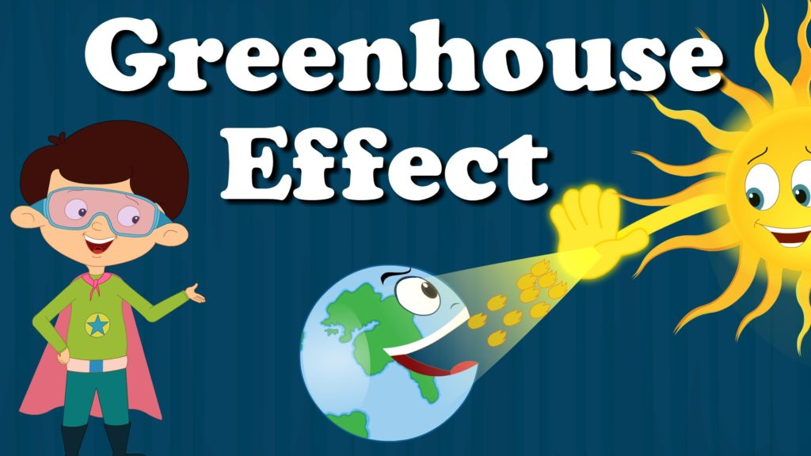
The heat produced by the sunlight is trapped in the greenhouse.
The greenhouse effect is a natural process that warms the Earth's surface.

Slide 5
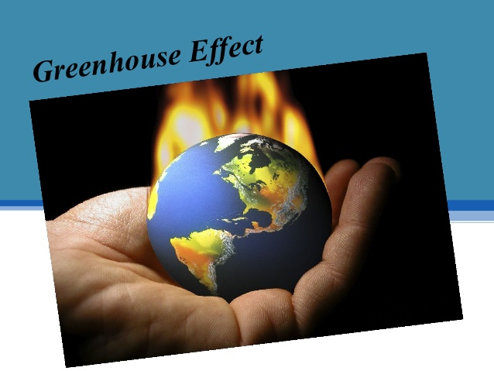
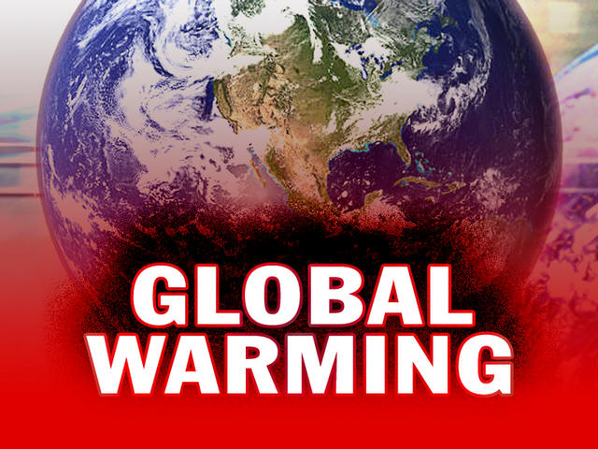
Now the Earth is hotter than previous due to green house effects.
Green House gases keep the world warm
In our previous lesson we learn about global warming
Global warming is making the Earth a dangerous planet

Slide 6
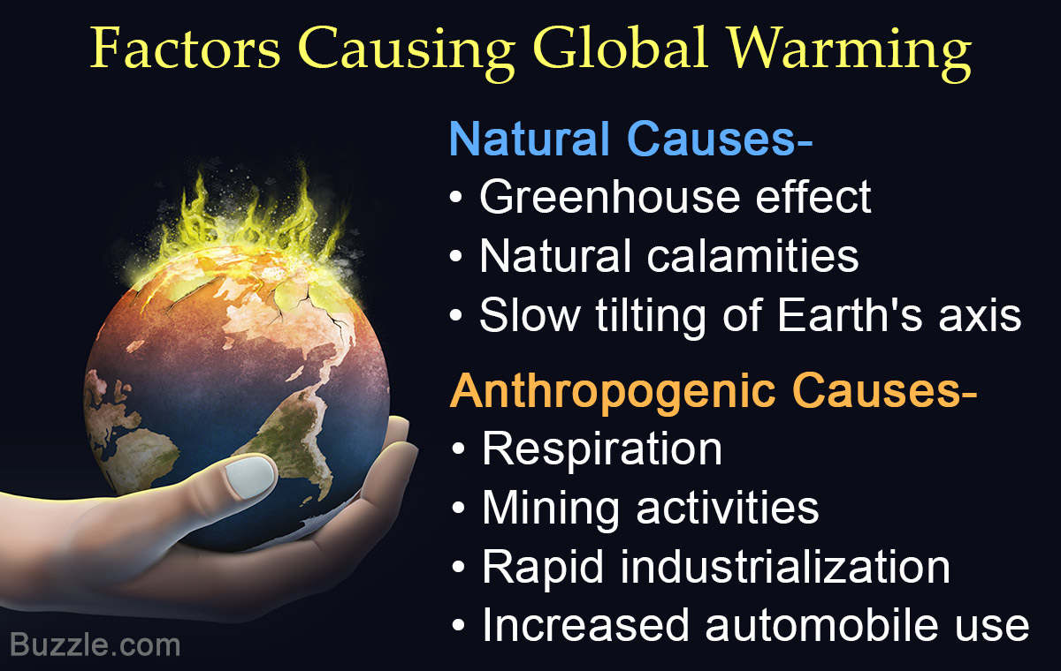

Slide 7
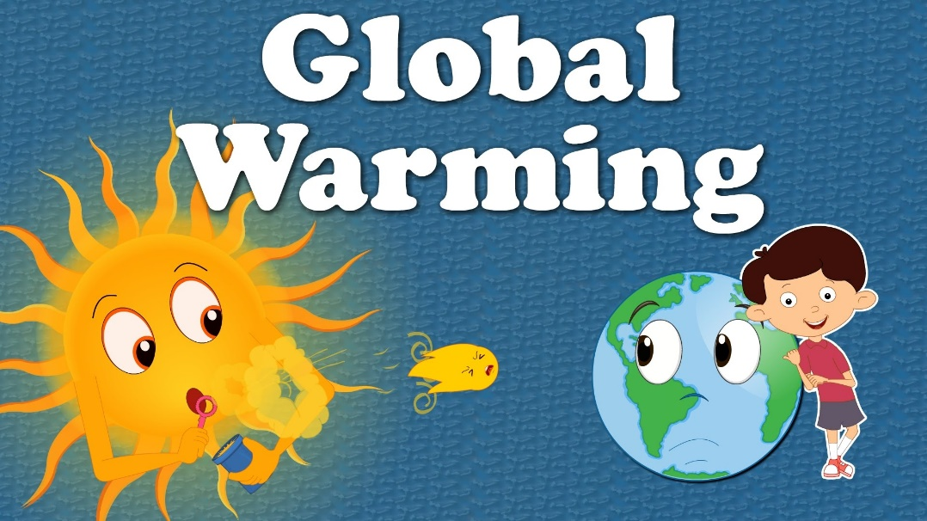
Do you know what happens as a result of global warming ?
Can you guess our today’s topic?
Topic: What happens next?
Unit: Nine
Lesson: Four

Slide 8
Learning Outcomes
      At the end of this lesson, we will be
      able to…
        read and understand text,
        describe the picture,
        change the degree of objective to denote the increasing threats of global warming.
        ask and answer questions.

Slide 9
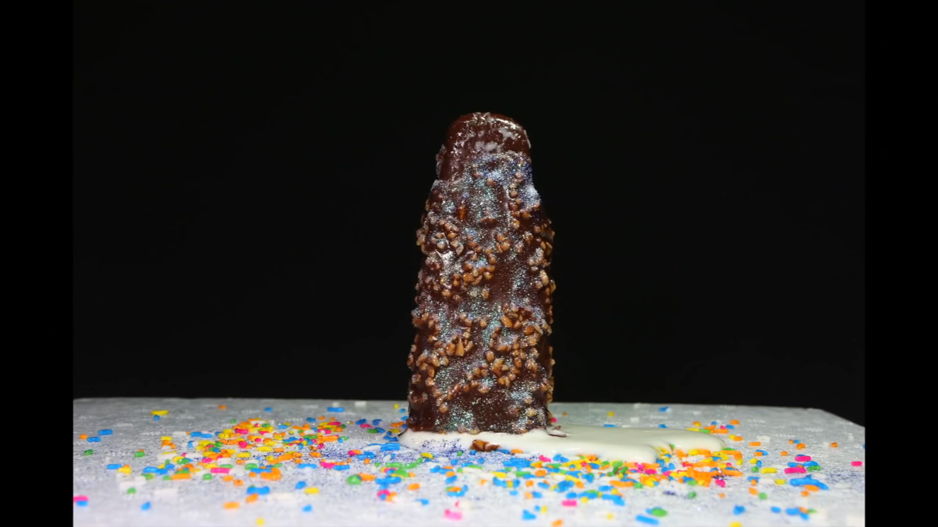
Let us watch a video
Ice-cream is melting due to heat.
World ice is melting due to global warming.

Slide 10
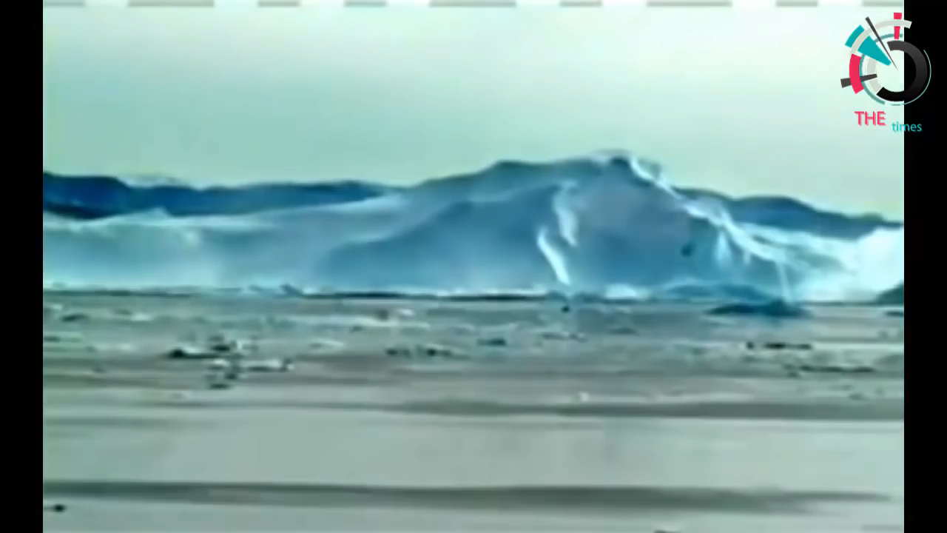
Let us watch another video how world ice is melting due to global warming.
The ice on earth is melting fast due to extreme heat.
Sea level is raising after melting ice.

Slide 11
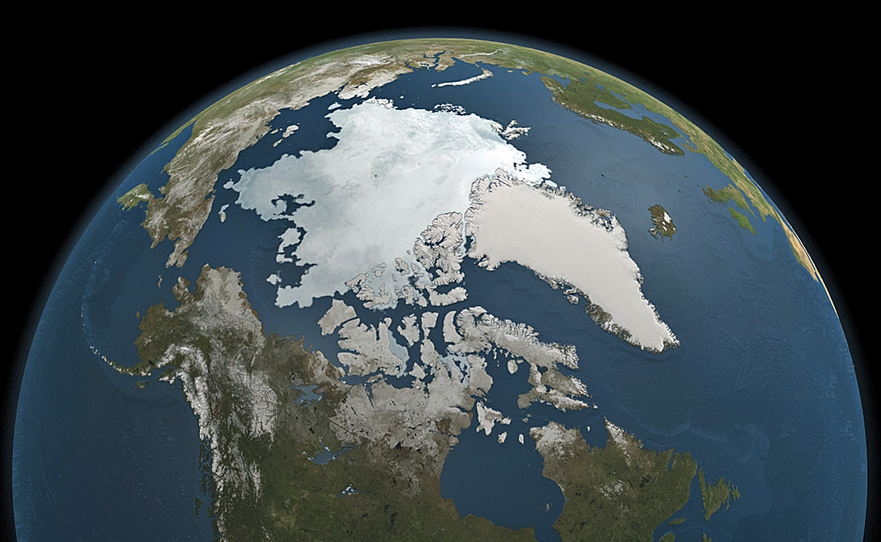
Three –fourths of the Earth’s surface is water, one-fourth is land.
When ice is melting water area is becoming larger than previous.

Slide 12
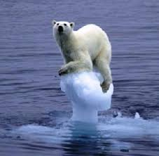
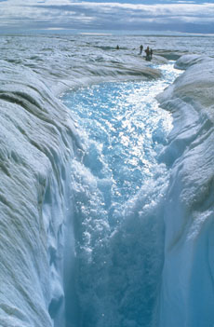
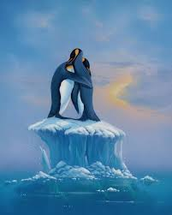
Result of melting ice
Animal at risk of extinction due to melting ice

Slide 13
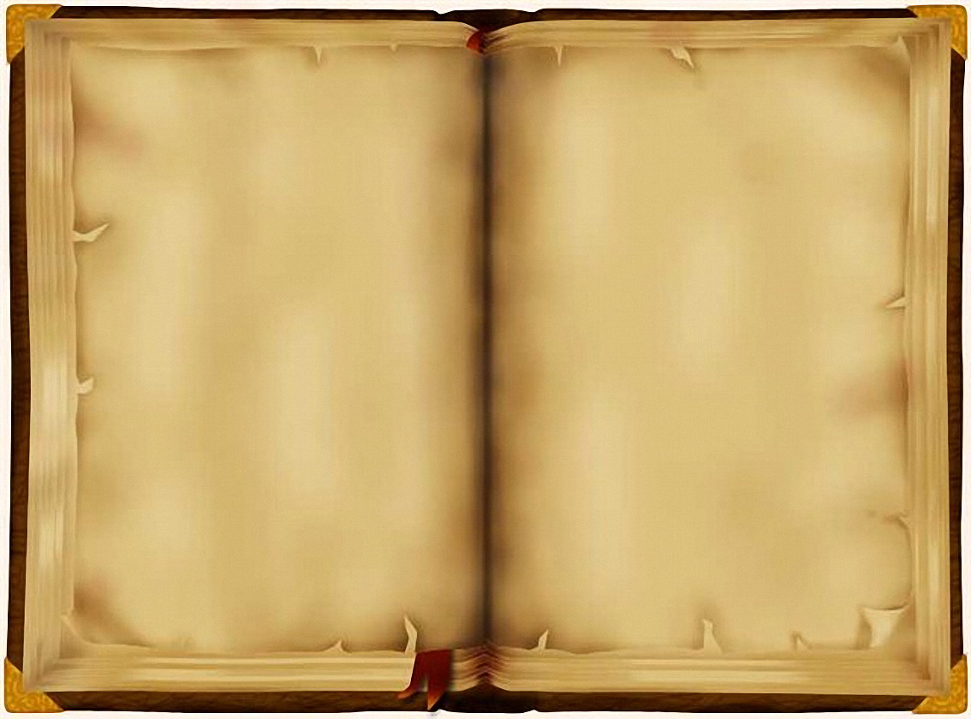
Read the text silently
What happens as a results of global warming? The ice on the earth surface is melting fast due to extreme heat. Oceans and seas are warming too. All the ice that melts will fill up the oceans and seas and they will overflow on land. Thus a huge area of land will go under water. Some of the best land for growing food is also the most low – lying.
That means it will be flooded fast. Even some big cities like London, Kolkata and Bangkok will get flooded. That means thousands of people will lose their houses and land and they will go hungry.
Moreover, as the earth’s climate warms up, the weather gets violent. Storms and cyclones will become more powerful. More areas will get drier and turn into desert. The will be heavier rains too. So there will be more floods and river erosions.

Slide 14
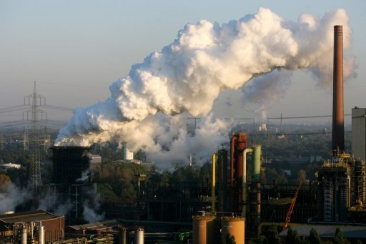
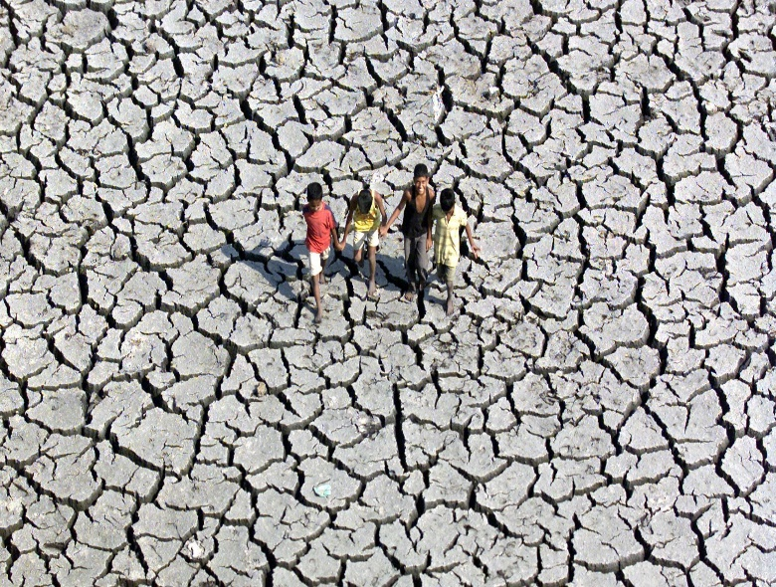
Let us think some key words above the text.
Individual work
Emission
The production or sending out light,
heat gas etc
We should try to stop industrial emissions.
A long period of time when there
is little or no rain.
Drought
The country’s entire grain harvest has been hit by drought.

Slide 15
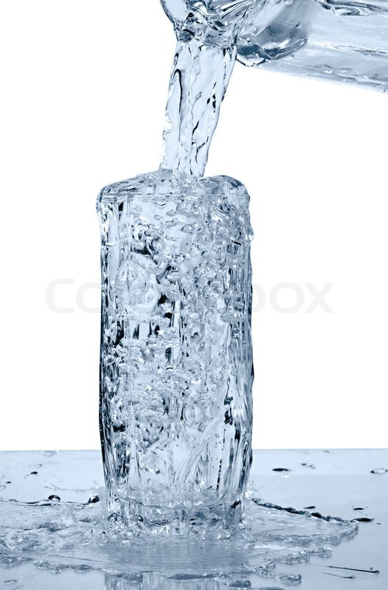
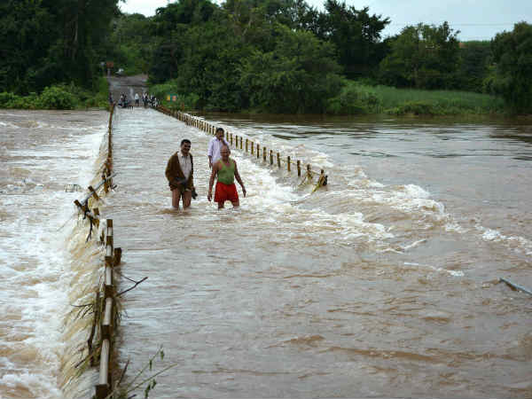
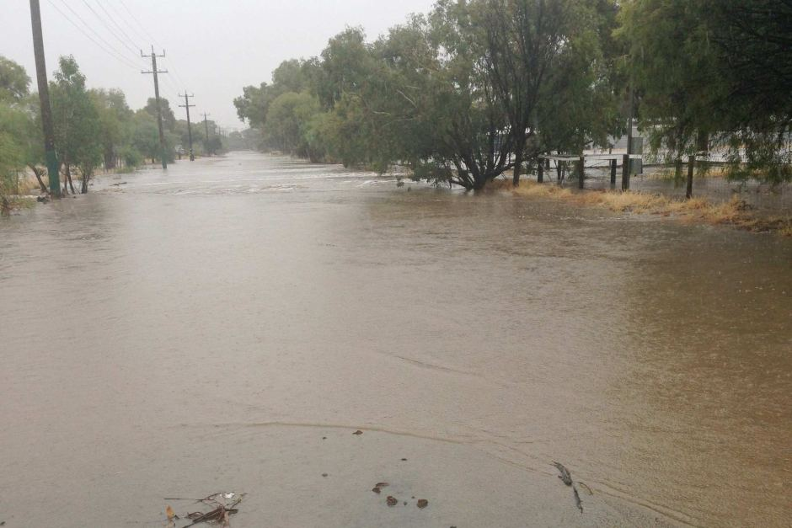
Overflow
Overflowing glass water and river water.
The river overflowed its bank.

Slide 16
GROUP WORK
Group -A
Why is the ice on the Earth’s surface melting fast?
Group -B
What will the melted ice do?
Group -C
What will happen to the crop land?
Group -D
What will happen to the people for gradual warming ?
Group -E
Why does the weather get more violent?

Slide 17
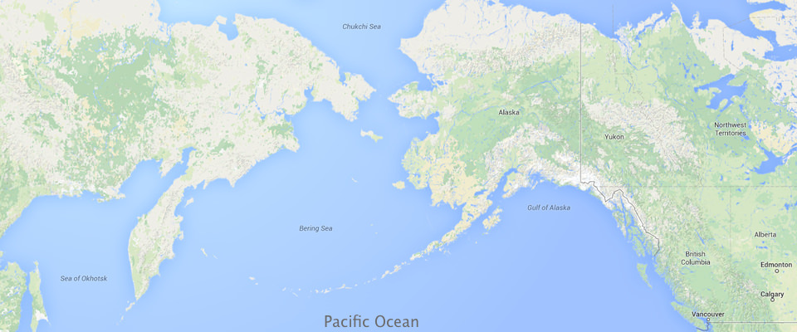
Ocean
Sea
Seas are found on the margins of the ocean and are partially enclosed by land. Here, you can see that the Bering Sea is part of the Pacific Ocean.
NB for teacher: trigger - ocean & sea

Slide 18
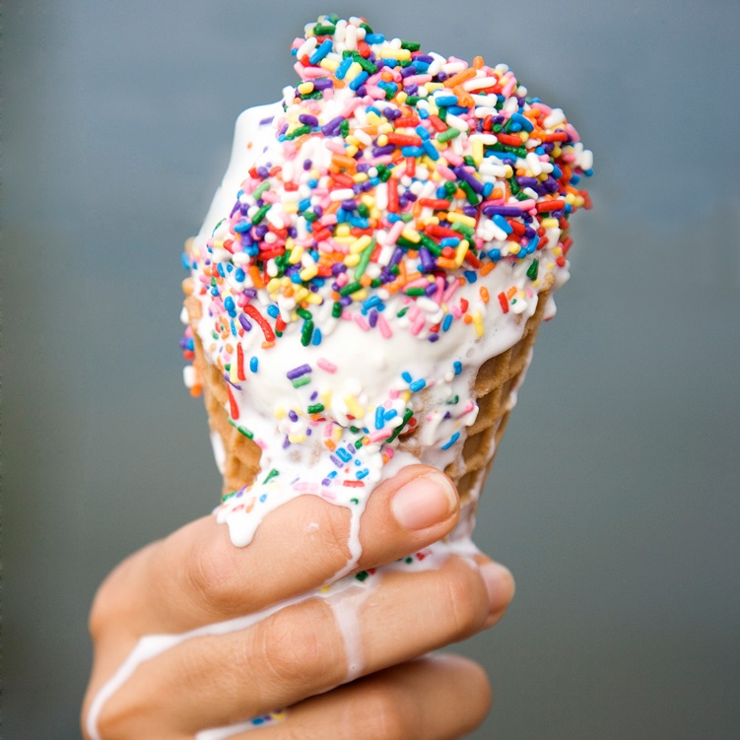
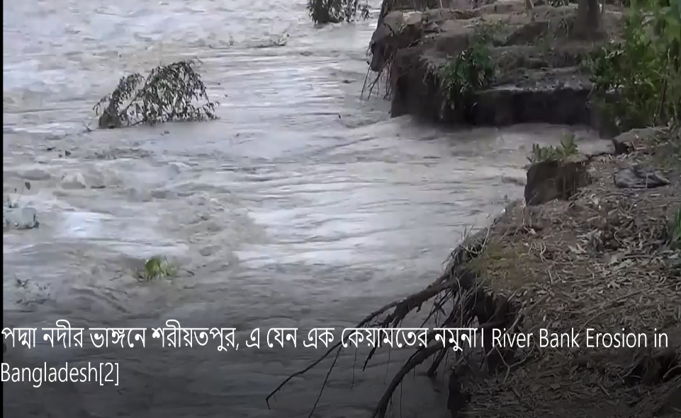
Make or become liquefied by heat.
Melt
Ice-cream is melting due to heat.
The process of eroding by wind, water, or other natural agents.
Erosion
River erosion is common scenario in our country.

Slide 19
Peer Work
Look at the some grammar point of today’s text.
Look at the underlined words.
Storms and cyclones will become more powerful.
More areas will get drier and turn into desert..
The will be heavier rains too
So there will be more floods and river erosions.
Tell the comparative form of the adjective
Deep
Cold
High
Deeper
Colder
Higher
Careful
Busy
More careful
Less careful
Busier

Slide 20

Pair Work
Write three sentences using the
comparative word ‘ taller’
Mina is taller than Rima.
Rima is taller than Shima
Mina is taller than Shima
Rima
Shima
Mina
Fill in the blank with the right from of degree in the brackets
Shoheb is (smart/smarter/ smartest) than Shakib.
Travelling (pleasant/more pleasant/ most pleasant) than many other things. more pleasant
A crow is ( ugly/uglier/ugliest) than a dove.
smarter
more pleasant
uglier

Slide 21
EVALUTION
Fill up the gap using following words
become
ice
famine
seas
brings
Global warming a) _____________ about natural disaster. Oceans and b) ___________ are warming for global warming. Thousands of people will encounter extreme c)_______________. For global warming d)___________ is melting. Cyclone and storm will c) _____________ stronger.

Slide 22
INDIVIDUAL WORK
Match the synonym words
EXTREME
Flow over
OVERFLOW
occur
HAPPEN
vast
HUGE
underfed
HUNGRY
excess

Slide 23
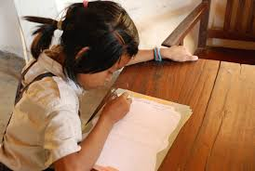
Home Work
Write a paragraph on the Effect of Global warming not more than 150 words.

Slide 24
This is the end of today’s session

Slide 25
Thanks for today’s class
Good bye, see you again

